Slide 1
Flexible fund funding approach
Information session
Thank you for joining us – the live event will start shortly
March 2026

Slide 2
Flexible fund funding approach
Information session
Welcome – please note this session will be recorded
March 2026

Slide 3
Information session agenda
Basis of our new funding approach
Cost-based funding approach
Similarities and differences to previous approaches
Key risk allocation changes
Contingency and Contingency Increase Level
Stage one financial model
Leasing

Slide 4
Basis of our new funding approach
Key objectives
Informed by
Greater transparency and focus on what is needed to provide new supply social housing and affordable rentals
Move away from “market rent" based contracts so:
  funding more closely reflects cost of service provision
  regional differences in market rent do not distort provision.
Ongoing dialogue with providers over many years.
Feedback from the finance sector through Social Housing Finance RFI in 2024.

Slide 5
5
Similarities and differences to previous approaches
Aspect | Cost-based funding model | Previous social housing funding | Previous affordable rental funding
Main funding approach | Ongoing subsidy | Ongoing subsidy | Upfront grant funding
Basis of approach | Cost | Market rent | Market rent
Tenant contribution | Included in amount agreed between Crown and provider (ie Agreed Amount) | Included in amount agreed between Crown and Provider (ie Market Rent + OS) | Sole source of ongoing revenue
Tenure | Social housing and affordable rental | Social housing | Affordable rental

Slide 6
Flexible fund cost-based funding model
Agreed Amount
Rent paid by tenant
(Income-Related Rent or Affordable Rental Contribution)
Revenue received by provider
Subsidy paid by the Ministry
(Income-Related Rent Subsidy or Affordable Rental Subsidy)

Slide 7
Flexible fund cost-based funding model
The Agreed Amount is:
Based on estimated costs: we want you to provide your best estimate of what these costs are. Funding covers ongoing costs of operation and servicing and repayment of debt.
Agreed at a project level (at stage two): Project agreed amount is further split into an agreed amount per home using percentages set out in the contract.
The total amount received by provider: tenant contributions are included in the agreed amount, not on top of it. The risk that the tenant contribution is lower than forecast is our risk, not yours. However, you will be responsible for collecting this contribution from the tenant.

Slide 8
Flexible fund cost-based funding model
8
Basis of annual adjustments to the agreed amount
Cost component | Description of adjustment
Rates | Adjusted annually in line with the annual change in “local authority rates and payments” as reported by Statistics NZ
Insurance | Adjusted annually in line with the annual change in “dwelling insurance” as reported by Statistics NZ
Tenancy management | Adjusted annually in line with the annual change in the labour cost index as reported by Statistics NZ
Other ongoing costs | Adjusted annually in line with the annual change in the consumer price index as reported by Statistics NZ
Debt servicing and repayment | Not adjusted
Contingency and risk margin | Adjusted annually based on the Contingency Increase Level agreed at contracting

Slide 9
Key risk allocation changes
Key changes to the risk allocation compared to previous social housing contracts are:
Specific indexing of high risk cost: Rates, dwelling insurance and tenancy management are indexed to their closest sub-index rather than general inflation.
Ability for provider to terminate for uninsurability: Crown will not require providers to continue to provide the service if they are not able to insure the homes.
Qualified change in law: Enables providers to be to be compensated for material changes in their cost profiles that are the direct result of a qualified change in law.

Slide 10
Contingency
Over the life of the contract, the Contingency is used to absorb cashflow requirements that are not otherwise provided for in other components of the Agreed Amount. For example:
Covering potential differences between:
  the index-adjusted cost components of the agreed amount and actual costs
  the debt servicing and repayment component of the agreed amount and actual debt servicing and repayment amounts (including interest rate changes)
Covering costs that are not otherwise included in the make-up of agreed amount, such as capital replacement costs.
Providing sufficient cashflow to meet debt covenants.

Slide 11
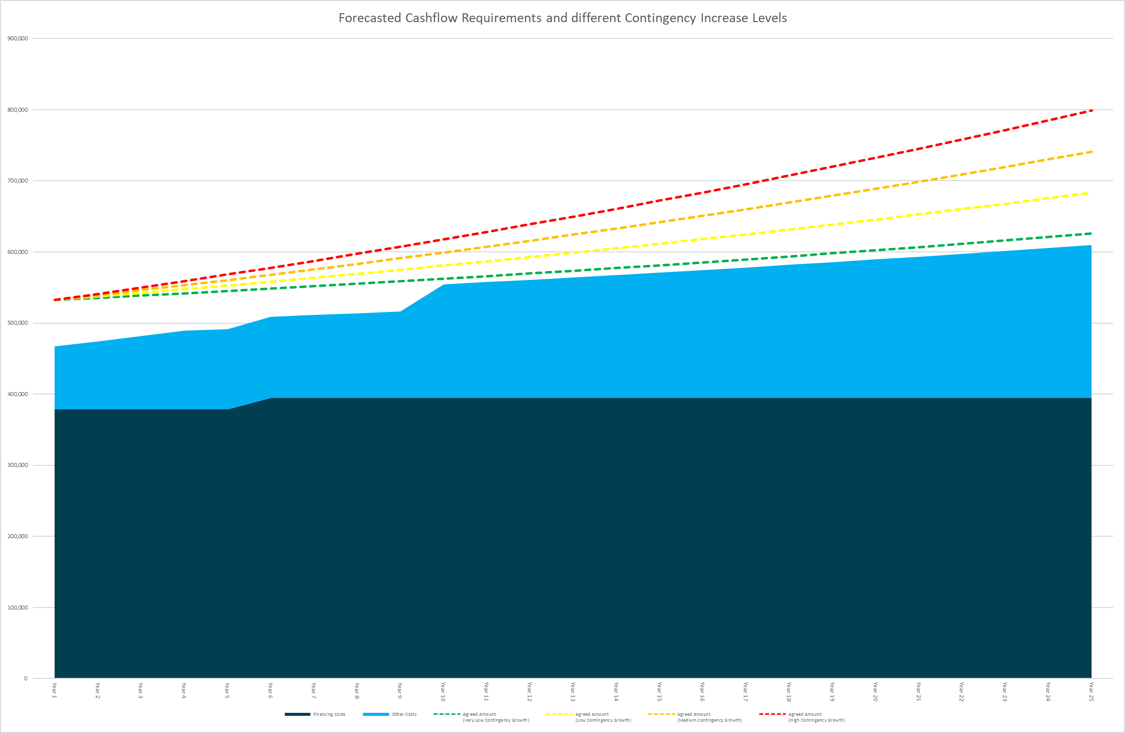
Contingency Increase Level
Rate at which the contingency component of the Agreed Amount increases
Impacts whole of life cost
Four options – very low, low, medium and high
Minimum rate of increase (very low) is CPI

Slide 12
Both are important and will be included in cost assessment
Contingency amount
(in financial model)
Crown year 1 cost
Impacts
Contingency increase level
Crown whole of life cost
Impacts

Slide 13
Sizing contingency and contingency increase level
When sizing the contingency amount and choosing the Contingency Increase Level, the applicants must take account of the following:
the minimum level of contingency for the project to be financially viable
key cost components such as rates and insurance will be adjusted according to the relevant inflation sub-index, providing a level of protection against extraordinary cost increases in these areas
the commercial term sheet provides for the Agreed Amount to be adjusted if a Qualified Change in Law results in your costs being materially higher than would otherwise be the case
payments will be sufficient to repay third party debt over the life of the contract, resulting in diminishing interest rate risk over time
ownership of the properties at the end of the contract term.
We require any requested contingency to solely fund the projects and applicable costs being procured in this process, and not wider properties or services provided by your organisation.

Slide 14
Stage one financial model
Overview:
High level, portfolio level overview: No project specific information (addresses or completion dates etc) required at this stage.
At least one model per location: You are welcome to complete a financial model for individual projects if you prefer.
Output is cost metrics for assessment: Crown year 1 cost and Crown whole of life cost

Slide 15
Stage one financial model
Editable cells:
Yellow shaded cells in “input” sheet: These are the substantive inputs to the financial model.
“Development costs” and “op and cap rep costs” sheets: Blank sheets for you to use for additional details or workings for the development costs and operating and capital replacement costs sections of the input sheet.

Slide 16
Stage one financial model walk through

Slide 17
17
Leasing
The same contract will be used (with limited changes) regardless of whether providers own or lease the homes.
There are two options for leasing under the flexible fund. The way the financial model can be utilised will depend on which option is proposed.
Long term contracts
Short term contracts
Work with your leasing partners to complete the financial model fully. Both parties will need to input into and be comfortable with the model.
Market rent can be included as a cost component in the contract (along with tenancy management and other costs).
Include market rent in “other costs” in cell D77 and note in cell F77.

Slide 18
Q&A

Slide 19
Thank you
Flexible fund information session
March 2026

