Slide 1

MAIHI Whare Wānanga
Maui Nukurau Tangata
Presentation to Ministers
02 December 2022

Slide 2
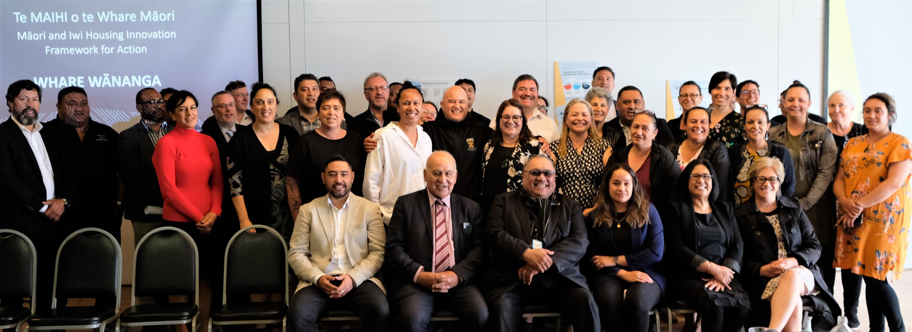
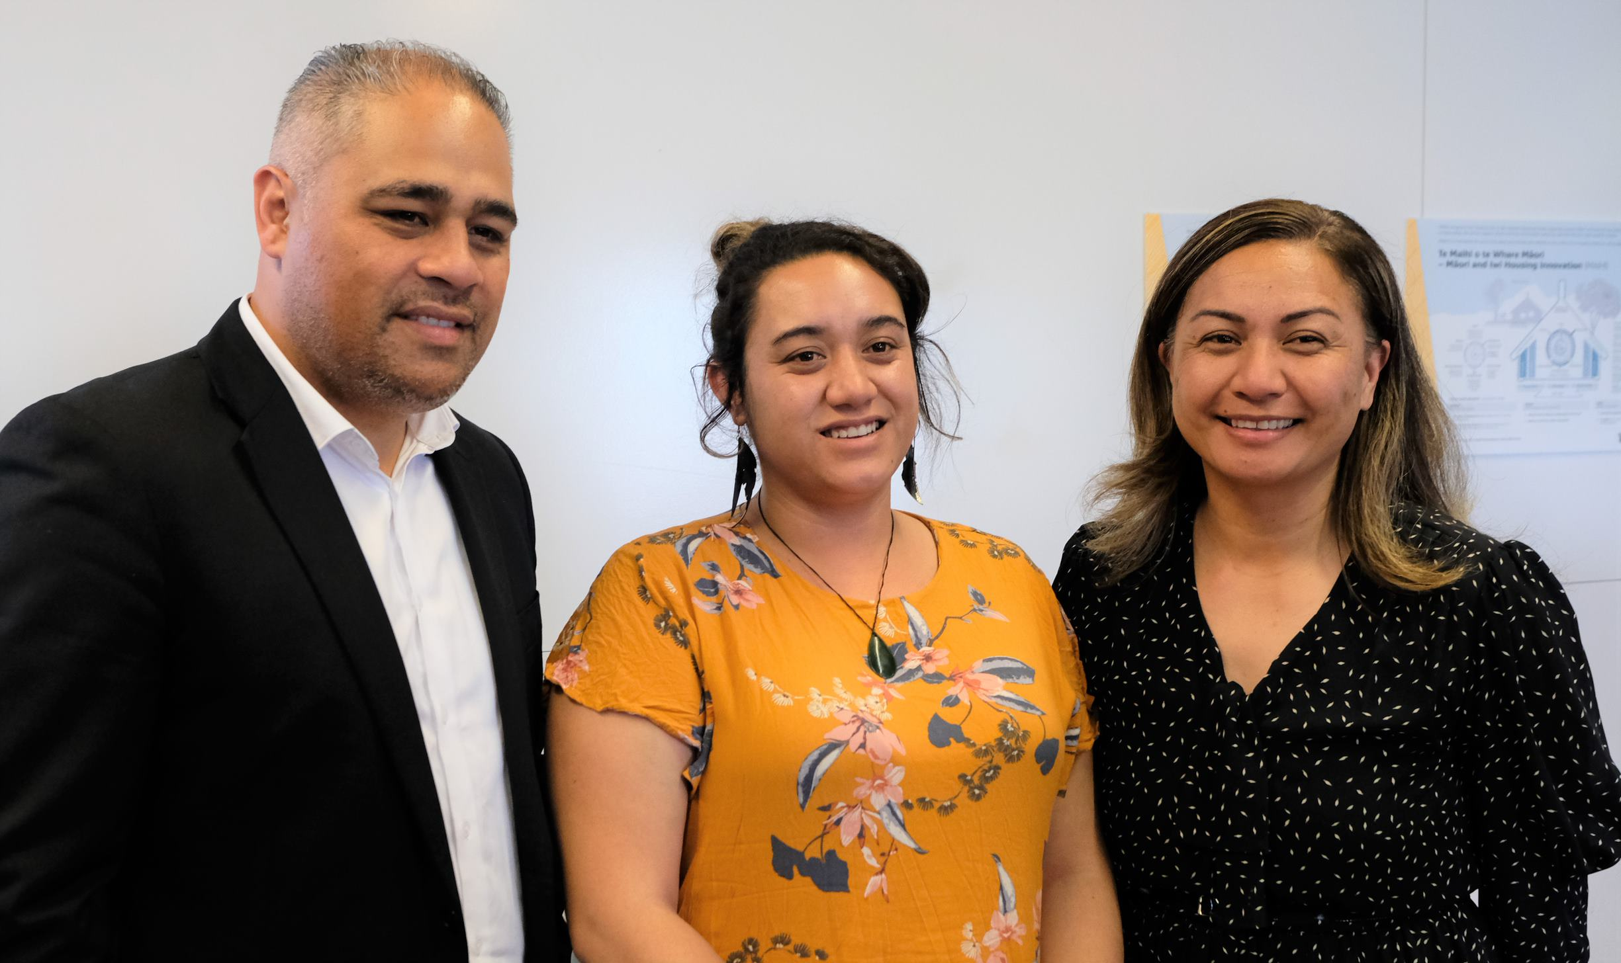
Te MAIHI Whare Wānanga 16 December 2020
The first Te MAIHI Whare Wānanga was held in Pōneke on 16 December 2020 and co-hosted by Te Tūāpapa Kura Kāinga and Te Matapihi.
Housing Ministers received a presentation of 15 recommendations from the December 2020 Iwi Housing Symposium in Napier. These recommendations were refined to 10 recommendations through the Whare Wānanga.
We will continue to work with iwi and Māori partners on how these recommendations could provide a foundation for the ongoing work programme on Māori housing.

Slide 3
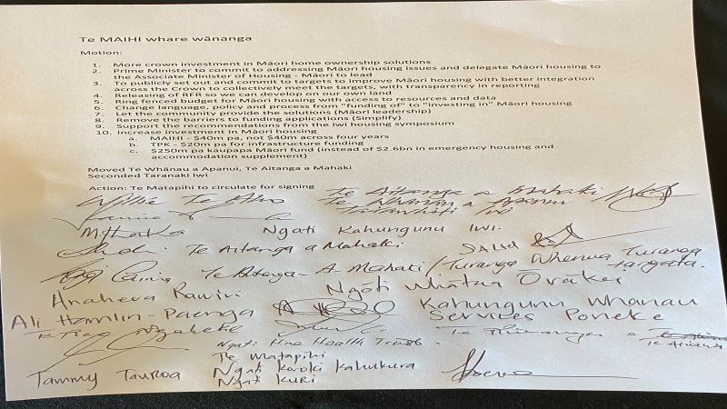

Slide 4
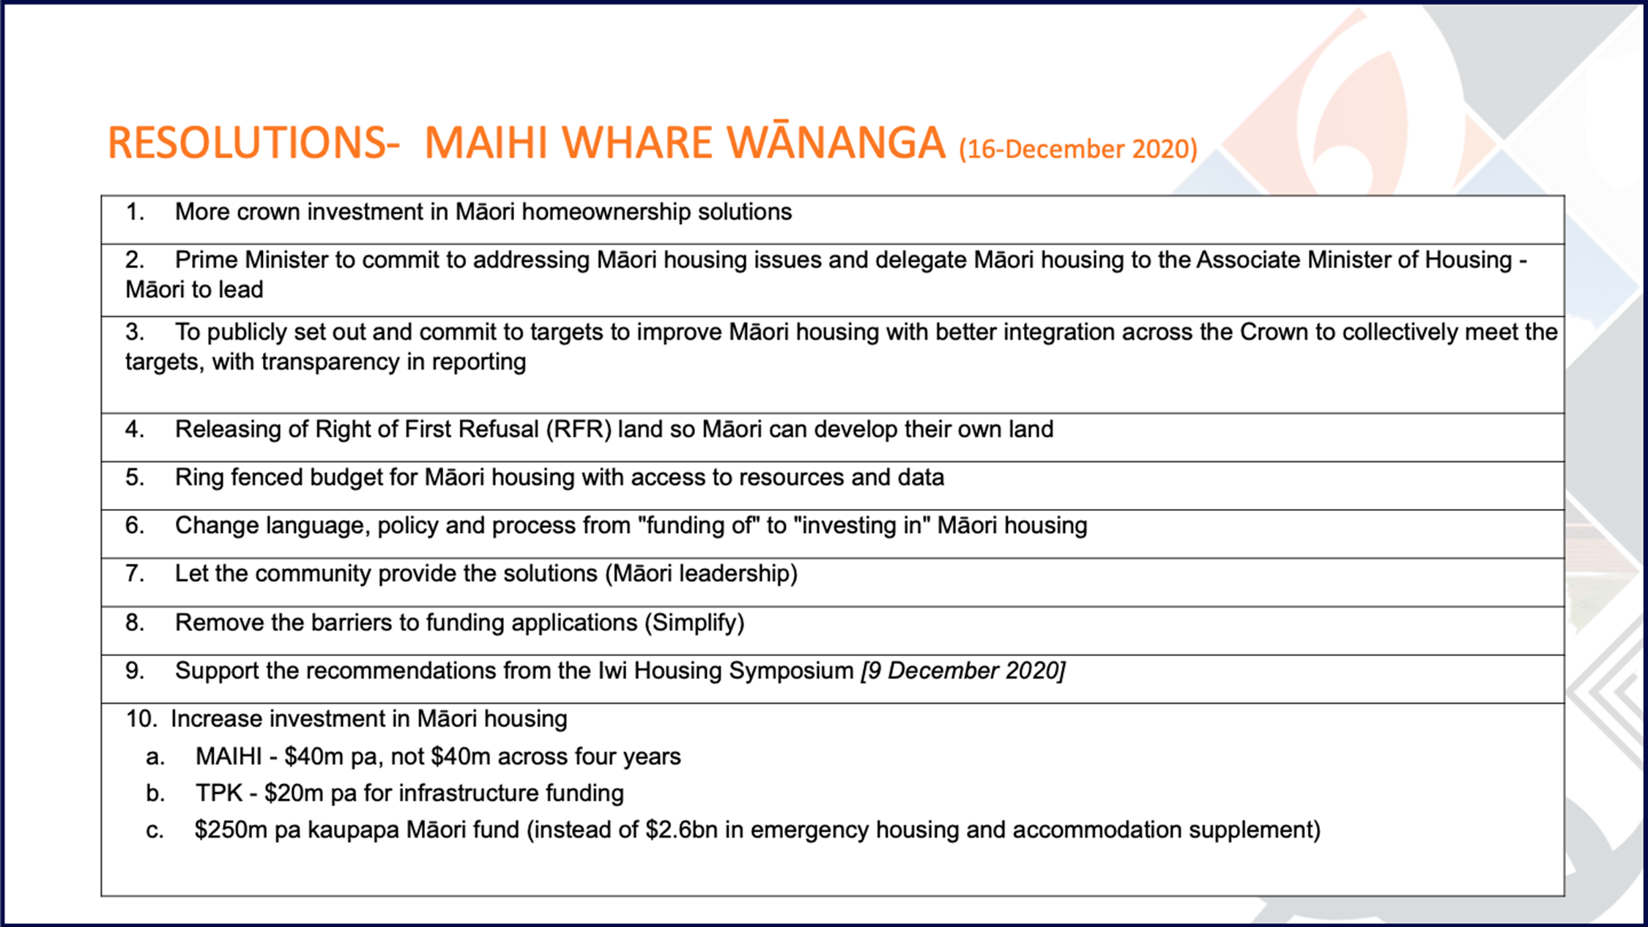

Slide 5
Mana Motuhake/Tino Rangatiratanga of hapū and Iwi
The hapū and iwi who have gathered at this MAIHI Whare Wananga maintain our Mana Motuhake/Tino Rangatiratanga as reaffirmed in Te Tiriti o Waitangi.
Our hapū and iwi determine issues of priority to us as Hapu/Iwi and how we work together with each other.
Our hapū and iwi work with the Crown on collective issues as Tiriti Partners.

Slide 6
Resolutions from Day 1
To develop a ‘single platform’ to make it easier for our whānau across a range of opportunities and obstacles to achieve their housing aspirations.
That Toitū Tairāwhiti is supported to be the exemplar prototype to lead the single platform approach.
Establish a one-stop shop Māori Housing Authority
Scale up and apply the Whai Kāinga Whai Oranga prototype model to housing delivery across the motu.

Slide 7
Resolution 1 & 2 Kōrero
To develop a single platform to make it easier for our whānau across a range of opportunities and obstacles to achieve their housing aspirations.
That Toitū Tairāwhiti is supported to be the exemplar prototype to lead the single platform approach.
What does that look like?
Pūtea - Financial Reform
  Access to finance - for Māori to access direct lending
  Ability for whānau on low income to access finance
  Review current polices and structures (e.g Kāinga Whenua loans review)
  New policies: Crown security/guarantee to Māori to achieve home ownership (e.g. 5% deposit)
  Planning – Create own consent authority for planning matters.
  Reducing barriers/access to achieve Resource Consents, Licence To Occupy, Long Term Plans, Occupation Orders.
  Māori Land Court – single process and judge(s) to look at MLC matters (with jurisdictions for special sittings). With additional resourcing to operationalise.
  Have our own residential tenancies service
  People/Rangatiratanga
  stable governance, governance training, integrated supply chain, regionally and nationally.
  Grow whānau financial literacy
  Partnerships – Actively grow public, private partnerships.
  Set targets for all-of-Government approach to housing delivery to Māori whānau, hapū, iwi
Moved: Ngāti Hine
Seconded: Ngāti Rehia

Slide 8
Resolution 3 Kōrero
Establish a one-stop shop Māori Housing Authority
What does that look like?
  Consolidate Māori housing functions/activities
  Reduce current siloed approach to funding
  Whānau oranga – transition from focus on ‘whare’ to ‘oranga’
  Governance – Underpinned by Te Tiriti o Waitangi, administered by Māori
  Monitoring function across Government
  Engage Māori Land Court, as the enabler to housing development on whenua Māori, to make their IT systems more friendly for whanau
Moved: Ngāti Hine
Seconded: Ngāti Rehia

Slide 9
Resolution 4 Kōrero
Scale up and apply the Whai Kāinga Whai Oranga prototype model to housing delivery across the motu.
  We are already doing it now in our regions. Don’t wish to lose this opportunity.
  Leverage off the current prototype models
  Accelerate housing delivery in our regions
Moved: Ngāti Hine
Seconded: Te Tihi Alliance

Slide 10
Te Paetawhiti, whakamaua kia tata.
Te Paetata, whakamaua kia tina.
Short-Term – Scale up the roll out of the Iwi prototypes and apply Whai Kāinga Whai Oranga delivery across the motu
Medium-Term – Develop the ‘Single Platform’
Long-Term – Establish a ‘one stop shop’ Māori Housing Authority

Slide 11
Next MAIHI Whare Wānanga Kaupapa
Consider housing supply for those (especially homeless) not covered by existing initiatives by Government (Kāinga Ora, HUD, TPK, MSD), CHPs, and iwi prototypes.
Increase support to Māori organisations (CHPs, whānau/ahu whenua trusts/land incorporations, hapū/iwi etc) to deliver housing through re-allocation of existing Government funding or allocate new funding.

Slide 12
Aa Taatau Whakatau
Internal Agreements of Whanau, Hapu and Iwi attending the MAIHI Whare Wananga on 1 December 2022

Slide 13
Working group to establish a Maori Housing Authority.
  Lead: Ema Williams (Whakatohea),Pita Tipene (Te Pouahi), Huhana (Te Pouahi), Materoa Marr (Te Tihi o Ruahine), Scarlet Mokaraka (Te Pouahi), Chrissy Hape (Ngati Kahungungu), Wayne Knox (Te Matapihi), Hemana Eruera (Kokohinau Papakainga Trust), Waimaria Houia (Toitu Tairawhiti), Tui Te Paa (Te Hiku Iwi Development) Geraldine Baker (Te Kahu o Taonui), Ivy Harper (Te Putahi o Te Waipounamu)
Establish a single procurement system for Iwi/Maori housing on issues of commonality.
  Lead: Willie Te Aho (Toitu Tairawhiti Housing), Pita Tipene (Te Pouahi), Chrissie Hape & Aayden Clarke (Ngati Kahungunu); Panapa Ehau (Hikurangi Enterprises), Dee-Ann Wolferstan (Te Runanga a Iwi o Ngati Kahu), Scarlet Mokaraka (Te Pouahi)
Working group to discuss access to capital: Lead: Wayne Knox.
  Lead: Wayne Knox (Te Matapihi), Tammy Tauroa (Ngati Kuri), Emma Edmonds (Te Pouahi), Nikki Waldren (Te Tihi o Ruahine), Taupara Eruera (Kokohinau Papakainga Trust), Ivy Harper (Te Putahi o Te Waipounamu), Bree Davis ( Te Runanga o Whaingaroa)
  Access to finance - for Māori to access direct lending
  Ability for whānau on low income to access finance
  Review current polices and structures (e.g Kāinga Whenua loans review)
  New policies: Crown security/guarantee to Māori to achieve home ownership (e.g. 5% deposit).
Te Matapihi (Wayne Knox) and Arohanui ki te tangata (and the iwi associated with this entity) to host a national hui to cover the following issues:
  Tipene Lemon (Kahui Tu Kaha, Te Runanga o Ngati Whatua & Arohanui ki te tangata) Tia Ashby (Te Hauora o Ngapuhi) Pita Tipene (Ngati Hine Health Trust) Bree Davis ( Te Runanga o Whaingaroa) Jordon Harris (Te Taumata o Ngati Whakaue) Toddy Shepherd (Te Korowai Trust), Ngati Kahungunu whanau Services
  Consider housing supply for those (especially homeless) not covered by existing initiatives by Government (Kāinga Ora, HUD, TPK, MSD), CHPs, and iwi prototypes.
  Increase support to Māori organisations (CHPs, whānau/ahu whenua trusts/land incorporations, hapū/iwi etc) to deliver housing through re-allocation of existing Government funding or allocate new funding.
  Update on 3 work group issues above.

